Slide 1
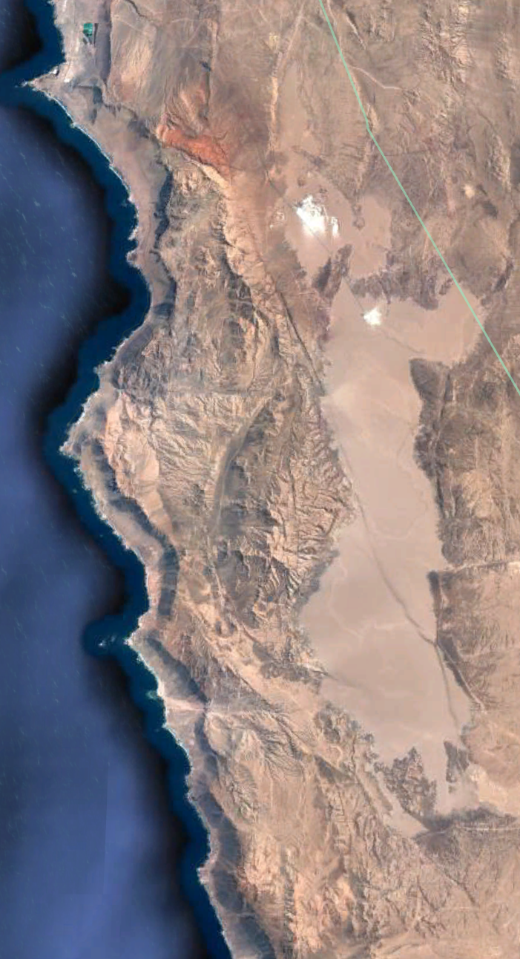
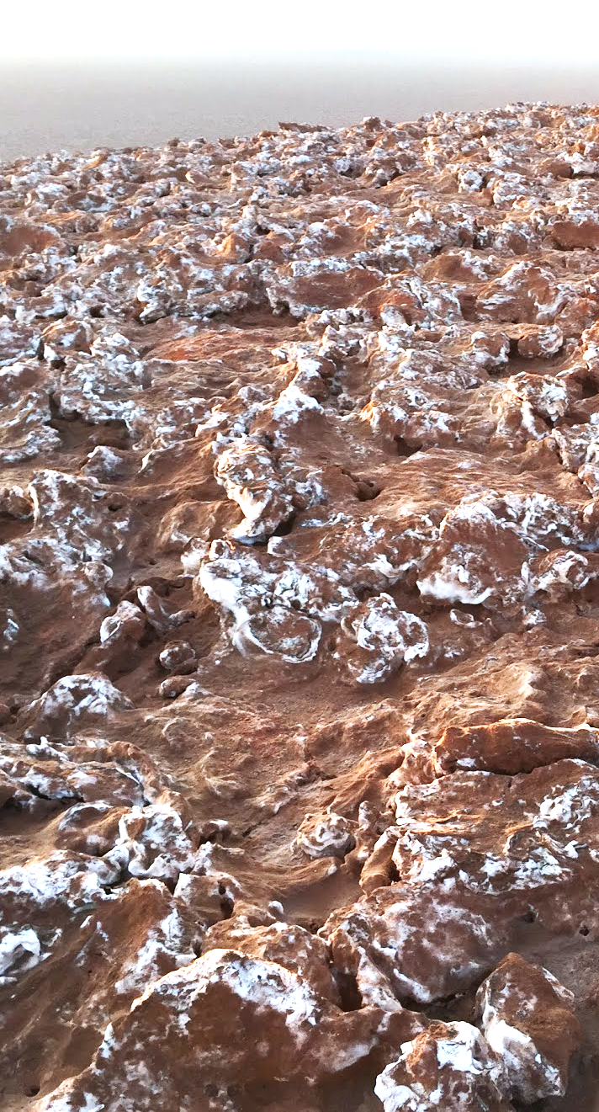
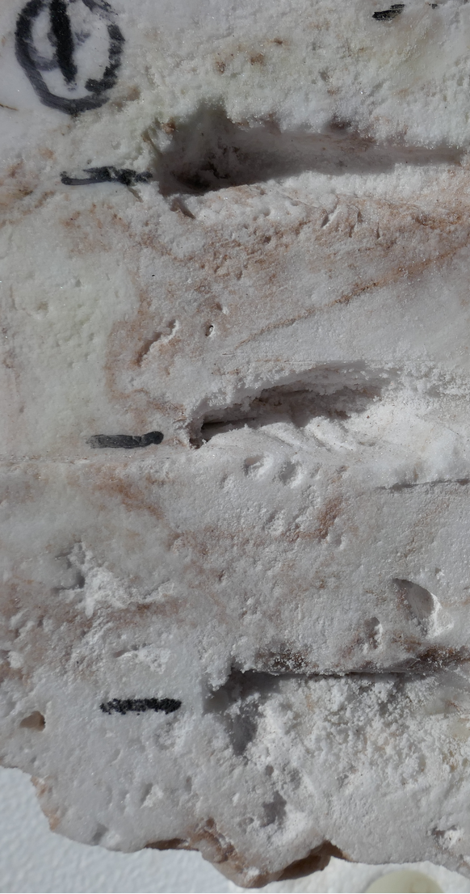
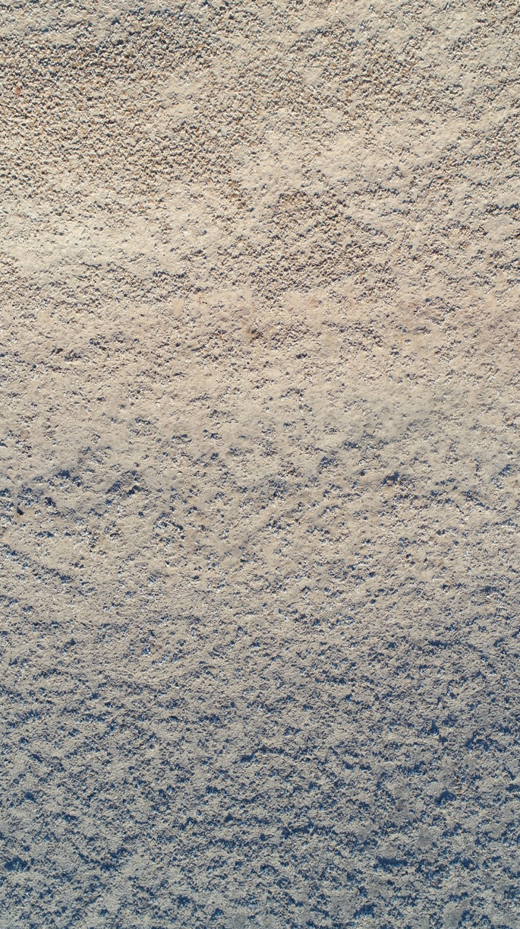
A.
B.
C.
North-Top
D.
Top
North-Top
North
Middle
South
North-Bottom
Bottom
5km
20m
20cm
3cm
Notes:
Figure: (A) Google Earth view of the entire Salar Grande, highlighting the sampling regions named SG1 and SG2. (B) A top-down drone image of the slope of the hill at SG1, showing the sampling areas at the top and bottom of the hill. (C) A cross-section of a model halite nodule, showing the locations of samples taken from the top, middle and bottom of the nodule in respect to the nodule’s original orientation.

Slide 2
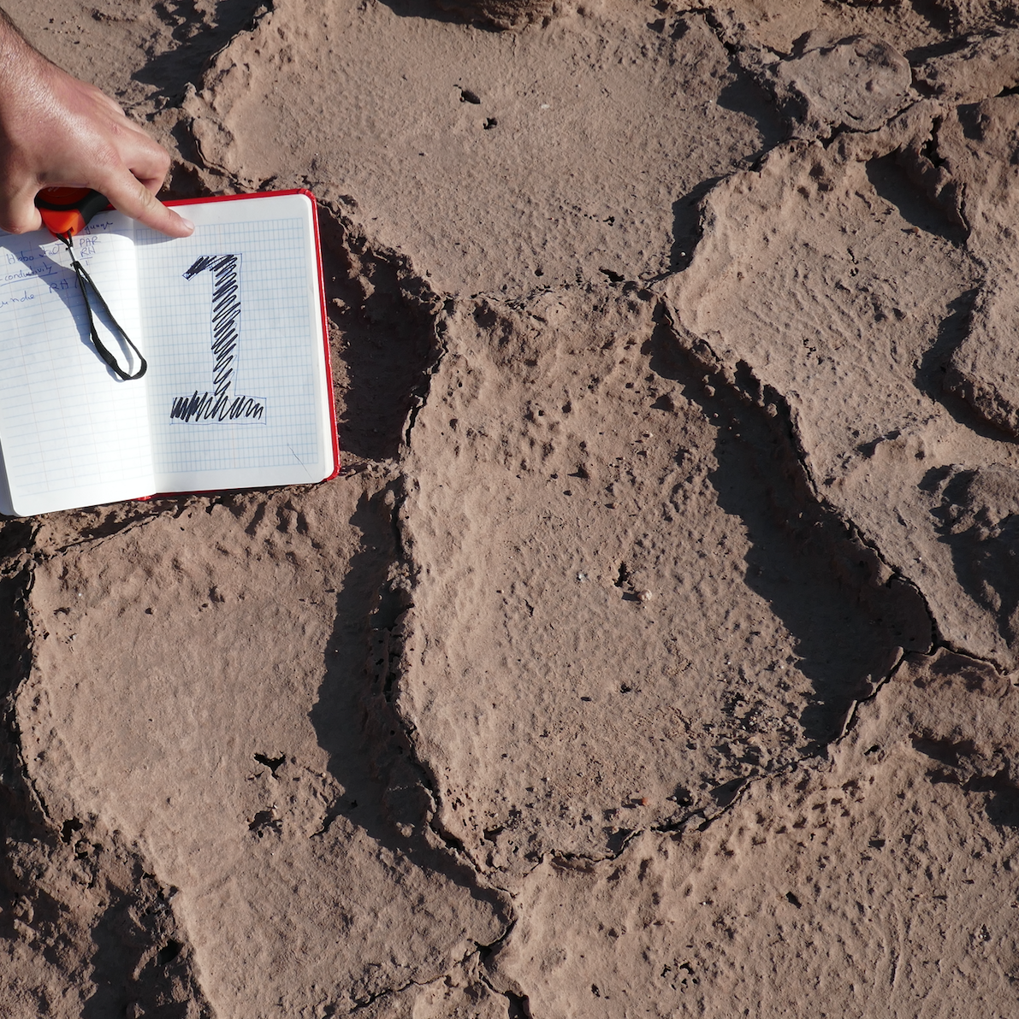
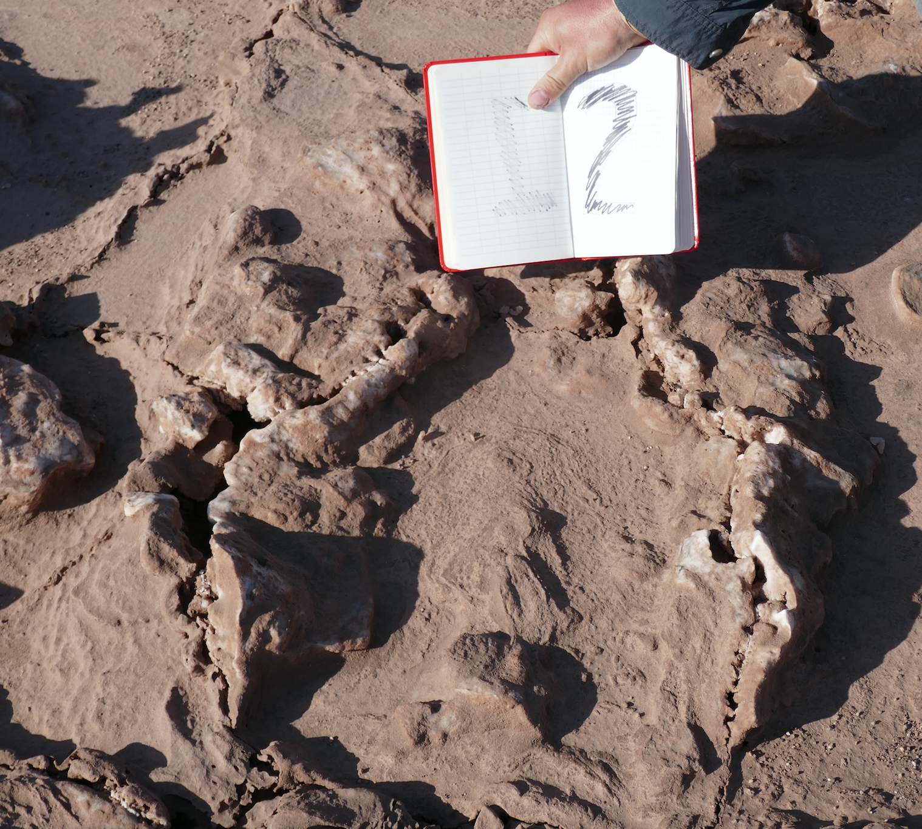
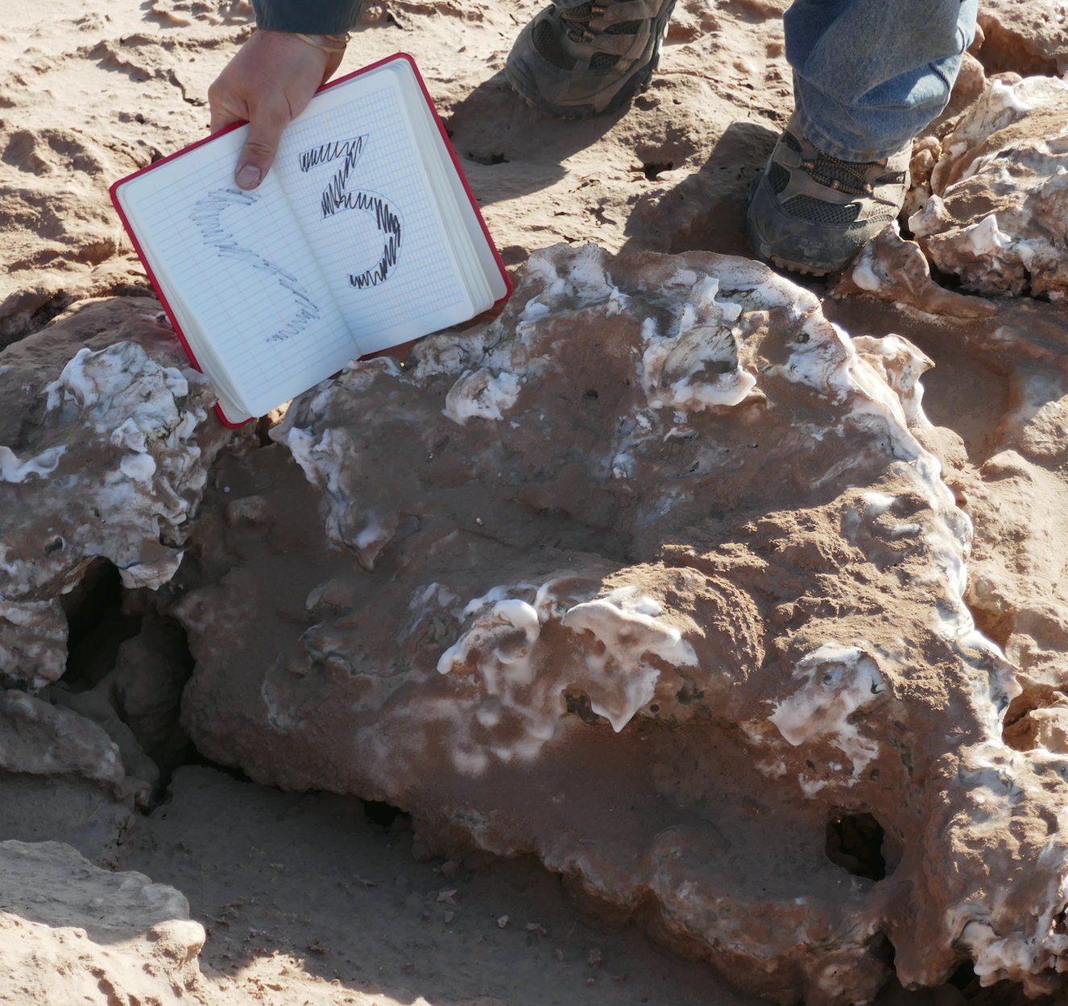
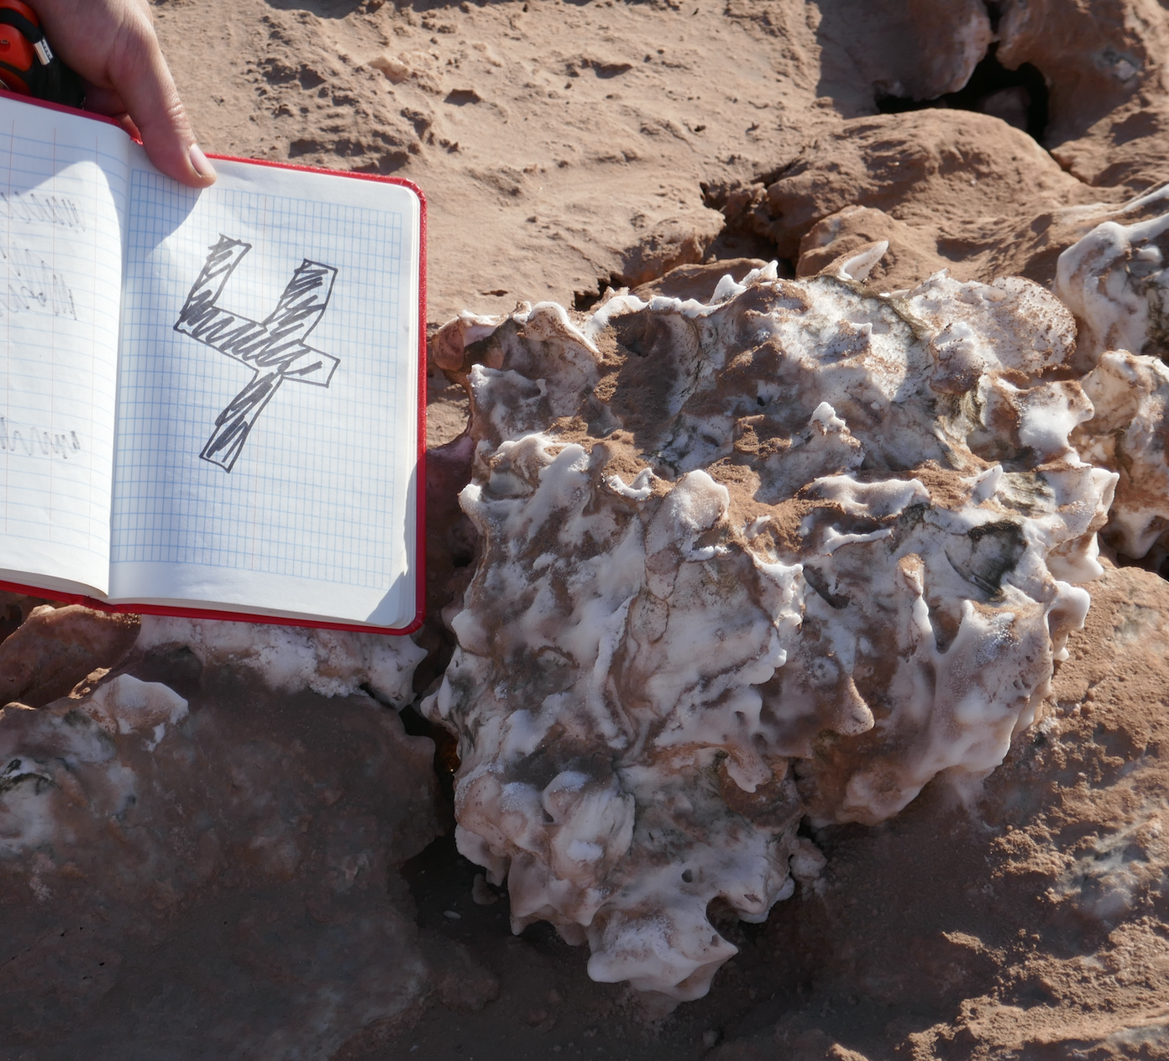
A.
B.
C.
D.

Slide 3
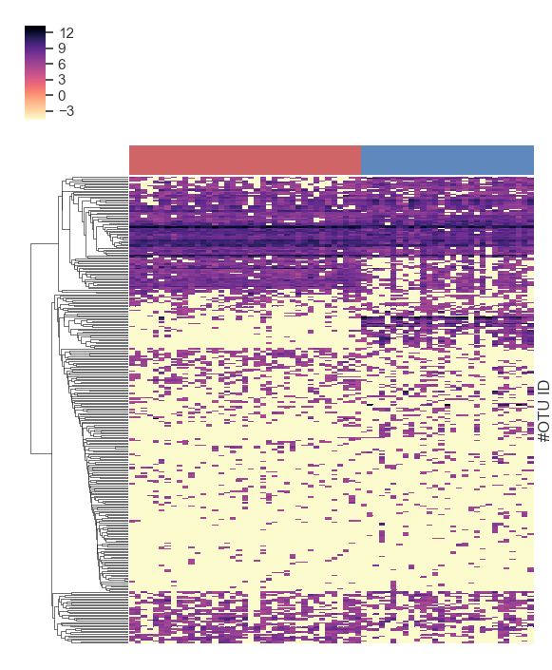
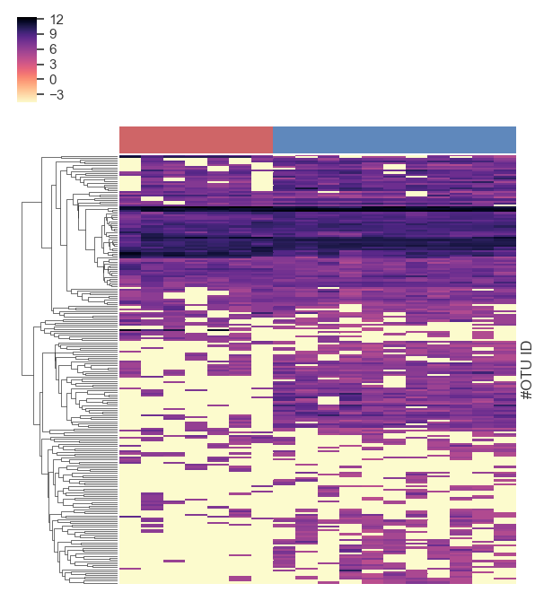
A.
B.
Regional scale
Landscape Scale
North South
North-bottom North-top
vb
vb

Slide 4
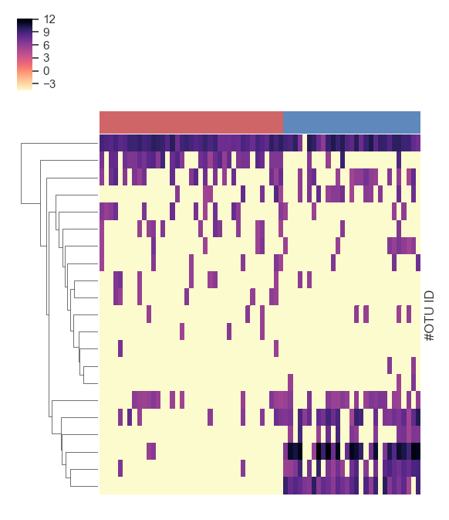
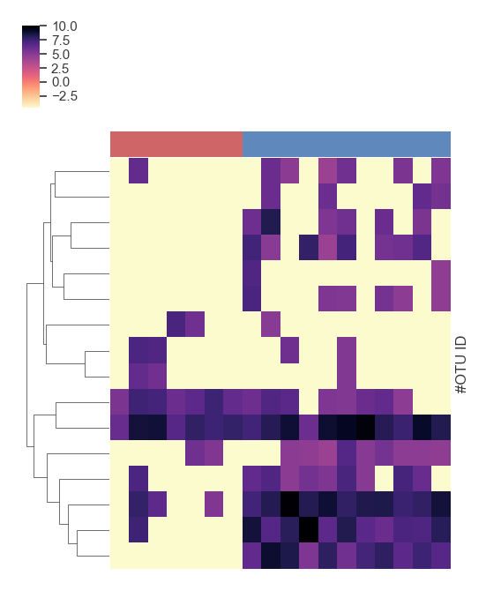
A.
B.
Regional Scale
Landscape Scale
North South
North-bottom North-top
vb
vb
vb

